Slide 1
Introduction to the Forms Julie Tomaro, BSN Washington State Department of Health
Interjurisdictional TB Notification (IJN) Transfer and Follow-up Forms

Slide 2
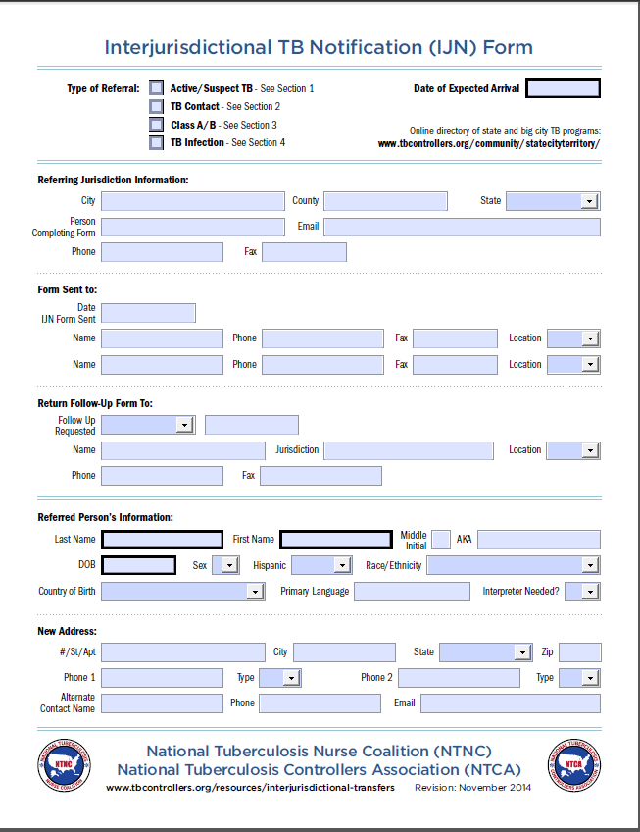
IJN Forms Online
The forms can be found on the National TB Controller’s Website at www.tbcontrollers.org/ resources/interjurisdictional-transfers
Notes:
It may be helpful to have the electronic version of the forms available as you move through this presentation. The forms can be found on the National TB Controller’s Website at www.tbcontrollers.org/resources/interjurisdictional-transfers

Slide 3
IJN Transfer Form
Page One: Top
--
Within 7 Days
Within 30 Days
Final
Other
Notes:
The first section of the transfer form contains information regarding the specifics of the referral. It allows you to choose from four referral types including active or suspect TB, TB contact, Class A/B, and TB infection. Depending on the referral type you choose, the form guides you to the applicable section of the transfer form that should be completed.
The date of expected arrival is also captured in this first section of the transfer form so that the receiving jurisdiction can find the date easily.

Slide 4
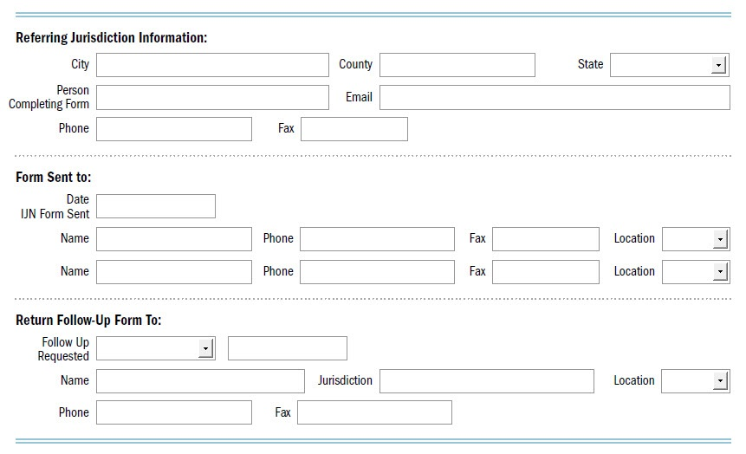
IJN Transfer Form
Page One: Middle
--
Alabama
Alaska
Arizona
Arkansas
California
Colorado Connecticut Delaware
--
State
County
Other
--
Within 7 Days
Within 30 Days
Final
Other – See right
Notes:
The next section of the transfer form captures the information of the referring jurisdiction, the receiving jurisdiction, and follow-up notification instructions. The referring jurisdiction is the state, city, or territory that is referring the TB patient to another state, city, or territory.
It is important that the referring jurisdiction fill out its contact information completely. The referring jurisdiction should also identify whom the transfer form is being sent to and when it was sent.
The form also asks the referring jurisdiction to indicate whether the form was sent to the state, county, or “other”. Typically the transfer form is sent to the state and the state forwards the information to the county. The “Location” drop box aims to identify forms that were not sent to the state so that they can be forwarded appropriately, and it also allows the state to see if the form has already been sent to the county so that duplicate notification can be avoided.
The “Return Follow-up Form To” subsection allows the referring jurisdiction to provide instructions for the receiving jurisdiction regarding preferred follow-up notification. The “Follow Up Requested” drop down box allows the referring jurisdiction to request follow-up notification within 7 days, 30 days, a final report, or “other” with a dialogue box to the right to specify.

Slide 5
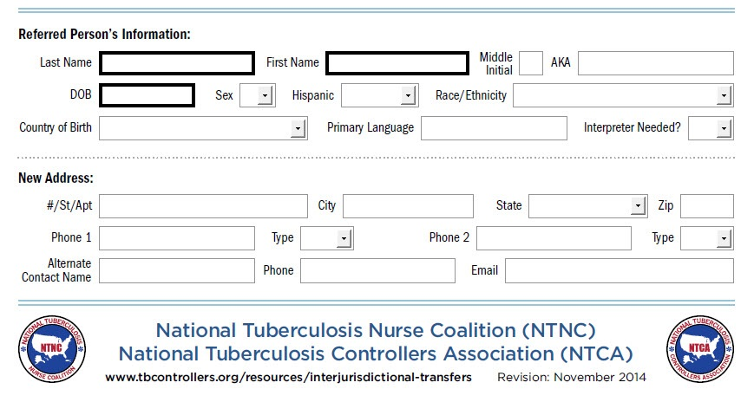
IJN Transfer Form
Page One: Bottom
--
American Indian
Alaskan Native
Asian
Black or African American
--
F
M
--
Yes
No
Unknown
--
United States
See Comments - Page 3
___
Abkhazia
Afghanistan
--
Yes
No
--
Home
Cell
Work
Notes:
This section collects information about an individual person being transferred. It collects basic demographic information in the same format as the Report of Verified Case of Tuberculosis (RVCT). For example, the options in the drop-down boxes for race/ethnicity and country of birth are the same options used to complete the RVCT. Notice that there is a field to enter the patient’s primary language and whether or not an interpreter is needed. If the interpreter is needed, then it is assumed that the language needed is the patient’s primary language.
It is imperative that the referring jurisdiction enter as much locating information as possible so that the receiving jurisdiction can locate the patient. In addition to the basic address, phone number, and email address information, there is also a place to record the name and contact information of an alternate contact, such as a spouse or roommate.

Slide 6
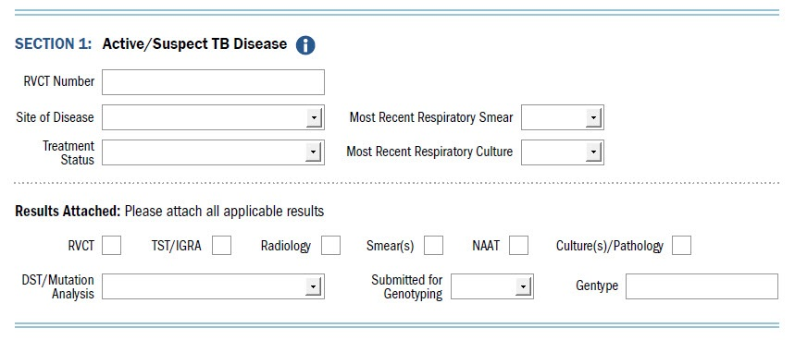
IJN Transfer Form
Page Two: Section 1
--
Positive
Negative
Unknown
N/A Not done
--
Pulmonary Extrapulmonary Pulmonary and extrapulmonary
--
Treatment started – See Section 5 Needs treatment
--
Positive
Negative
Unknown
N/A Not done
--
Pansensitive INH resistant RIF resistant EMB resistant PZA resistant Multidrug resistant Other – See attached results
--
Yes No
Unknown
Notes:
The second page of the transfer form collects information pertaining to the referred person’s current TB status. Keep in mind this transfer form is not meant to be a duplicate of the RVCT or medical record, but is a quick overview of the patient. The RVCT form and medical information such as lab or imaging results should be sent as an attachment along with this form.
Throughout the following four sections, you’ll notice blue information icons. Clicking on these icons will take you to online resources that may help in filling out the form.
Section 1 applies to active or suspect TB disease. The referring jurisdiction should document the RVCT number if applicable, the site of disease as pulmonary, extrapulmonary, or both, and the treatment status. If treatment was started, then Section 5 will need to be completed. The form also includes drop-down fields for recording the most recent respiratory smear and culture results. It is important for the receiving jurisdiction to know if the referred person is a transmission risk at the time of arrival.
Additional diagnostic information should be sent as an attachment along with the transfer form. Notice the “DST/Mutation Analysis” drop-down field. While the results should be sent as an attachment, selecting a result in the drop-down allows the receiving jurisdiction to quickly determine if the patient has known drug resistance. Also note that “Submitted for Genotyping” has a drop-down field. This is due to the fact that genotyping results often are electronic notifications rather than a printable report that can be attached.

Slide 7
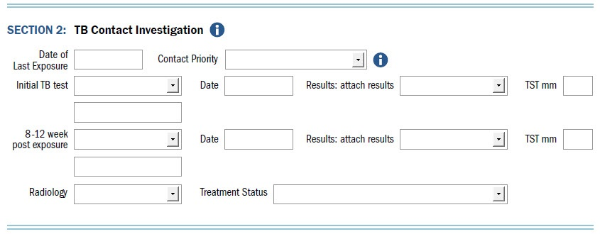
IJN Transfer Form
Page Two: Section 2
--
High Medium/close
Low/other-than-close
--
TST QFT-GIT T-Spot Needs testing
N/A Other
--
Negative
Positive
Indeterminant Borderline Not done
--
Attached Not done Pending Needs x-ray
--
Treatment started – See Section 5 Needs treatment
Window prophylaxis started – See Section 5 Needs window prophylaxis N/A
Notes:
Section 2 is a place to record information about a contact being referred. “Date of Last Exposure” is important information to include so that the receiving jurisdiction knows if the patient will need two TB tests or just one. The options in the “Contact Priority” drop-down field are consistent with CDC’s recommendations (see the link in the information icon) to prioritize contacts as high, medium, and low. Some jurisdictions only have the resources to evaluate high-priority contacts.
The form gives the referring jurisdiction a place to record TB testing information. In the drop-down options, you can specify the type of test, if the person needs an initial TB test, or not applicable. For instance, maybe no initial test was completed because the contact was located 8-10 weeks after exposure; and, therefore, the contact’s testing results would be recorded in the 8-12 week post exposure field.
Notice that this form allows you to specify in the “Treatment Status” box if the person is on window prophylaxis or needs window prophylaxis.

Slide 8
IJN Transfer Form
Page Two: Section 3
--
A – Active pulmonary B1 – Noninfectious pulmonary B2 – Noninfectious extrapulmonary B3 – TB infection B4 – TB contact
--
Yes No
--
Results attached Needs test N/A
--
Results attached Needs sputa N/A
--
Treatment started – See Section 5 Needs treatment
N/A
Notes:
Section 3 is specific to class A/B immigrants and refugees. Not infrequently, refugees or immigrants arrive in the U.S. and move to a different jurisdiction before there TB evaluation is complete. If that occurs, then information is collected in this section. The referring jurisdiction should record the TB classification, the alien number, and indicate if the transfer in the Electronic Disease Notification (EDN) database has been completed. Information about any screening that has already been completed or that needs to be completed should also be recorded.

Slide 9
IJN Transfer Form
Page Two: Section 4
--
Treatment started – See Section 5 Needs treatment
N/A
Notes:
Section 4 is for patients who have been diagnosed with latent TB who are not known contacts to a case or a Class A/B immigrant or refugee.

Slide 10
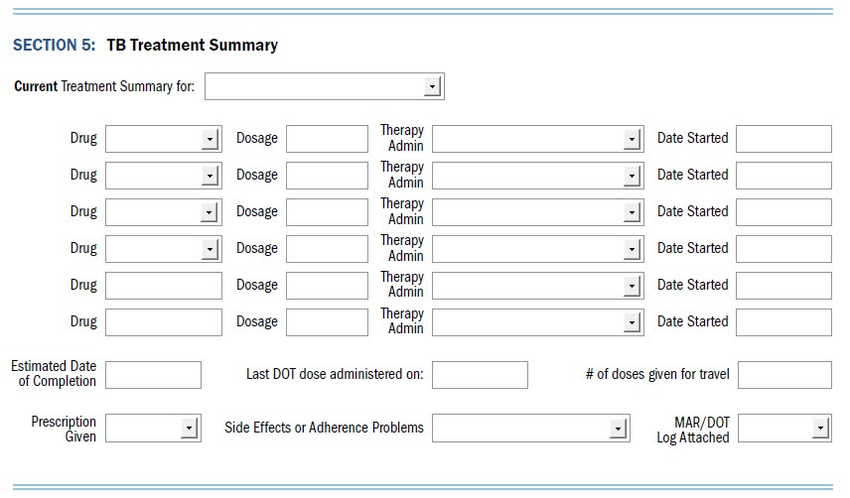
IJN Transfer Form
Page Three: Section 5
--
Active/suspect TB
TB infection
Window prophylaxis
--
Isoniazid
Rifampin
Pyrazinamide
Ethambutol
Streptomycin
Rifabutin
Rifapentine
Ethionamide
Amikacin
--
Daily DOT
Daily SAT
5x weekly DOT
5x weekly SAT
3x weekly DOT
3x weekly SAT
2x weekly DOT
2x weekly SAT 1x weekly DOT 1x weekly SAT
Other- See attached MAR
--
Yes
No Unknown
--
Yes – See attached notes
No Unknown
--
Yes
No
Notes:
Section 5 allows the referring jurisdiction to record a summary of the treatment that patient is currently receiving. Again, the information recorded in this section should only reflect what the patient is receiving at the time they are being transferred. If they are on the continuation phase of treatment you would only record the isoniazid and rifampin. The rest of the treatment history is going to be attached as a MAR or DOT log.
The first drop-down field, “Current Treatment Summary,” indicates if the treatment is for TB disease, TB infection, or window prophylaxis. Then the current drugs that the patient is on are entered into the “Drug” fields. Notice that the first four “Drug” fields have drop-downs lists that contain all of the drug options currently available for reporting on the RVCT. The bottom two “Drug” fields are text fields so that you can record any other non-traditional TB medications the patient might be receiving. Once the drug is selected, record the dosage and indicate how the medication is being administered: by directly observed therapy (DOT) or by self-administered therapy (SAT).
Then indicate the estimated date of completion, record the last DOT dose administered before the patient moves, and indicate how many (if any) doses are given for travel.
You may also indicate if a prescription for TB medication was given to the patient, and if the patient has been experiencing any side effects or adherence issues which should be detailed in an attachment.

Slide 11
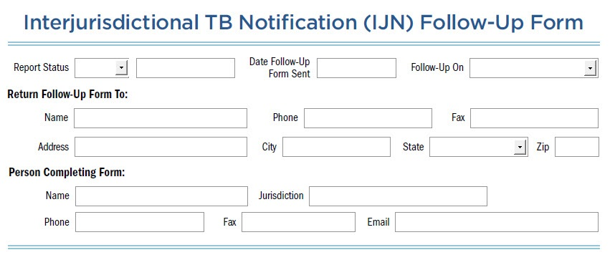
IJN Follow-up Form
First Quarter
--
7 Day
30 Day
Final
Other:
Active/ Suspect TB Contact
Class A/B
TB Infection
Notes:
IJN Follow-up Form: The follow-up form is what the receiving jurisdiction uses to communicate any follow-up that has occurred back to the referring jurisdiction.
When sending the follow-up form indicate if this is a 7 day follow-up, 30 day follow-up, final report, or “other”, the date the follow-up form is sent, and the type of patient the follow-up form is addressing.

Slide 12
IJN Follow-up Form
Second Quarter
--
F
M
--
Yes
No
Unknown
--
American Indian
Alaskan Native
Asian
Black or African American
Notes:
The Referred Person’s Information is important in helping to link the follow-up form with the original transfer form. The referred person’s information should match what was on the original transfer form.

Slide 13
IJN Follow-up Form
Third Quarter
--
No Infection/Disease
TB Infection
Active Disease
Pending
Unknown
N/A
--
Continuing
Started
Stopped
Not started
Complete
Referred
N/A
--
Initiated
Completed
Not Done
Referred
N/A
--States--
Alabama
Alaska
--
QFT
T-Spot
--
Pansensitive INH resistant RIF resistant EMB resistant PZA resistant MDR Other – See comments Other – See attached results
Notes:
The Follow-Up Information section allows the receiving jurisdiction to indicate where it is in the evaluation process. Record if the evaluation has been initiated, completed, not done, or if the patient was referred out for evaluation. Record the evaluation outcome to date: whether a diagnosis has been made, is pending or unknown. If the patient was diagnosed as an active case, indicate who the counting jurisdiction will be to assure that case counting does not get missed. Indicate the treatment status of the patient. Attach copies of all applicable diagnostics.

Slide 14
IJN Follow-up Form
Fourth Quarter
--
Completed Treatment
Not TB Infection/Disease
Never Located
Lost
Died
Refused
Moved
Other – See right
--
Yes
No
Notes:
If all follow-up on the patient has been completed, then disposition the patient, indicating the date of disposition and the reason that the patient is dispositioned.
If the patient is dispositioned because he or she has moved, then indicate the patient’s new address and contact information and whether or not the new jurisdiction has been notified.

Slide 15
Wrap Up
NTCA/NTNC Interjurisdictional Transfers:
http://www.tbcontrollers.org/resources/ interjurisdictional-transfers/
Please submit any questions or comments about the form to ntca@tbcontrollers.org
Notes:
This concludes the introduction to the Interjurisdictional TB Notification Transfer and Follow-up Forms. The forms and instructions are housed on the NTCA/NTNC’s Interjurisdictional Transfers
web page at the link listed on the screen. Please submit any questions or comments about the form to ntca@tbcontrollers.org.

