Slide 1
Tuberculosis in Prisons & Jails:
Public Health
Challenges and Opportunities

Slide 2
Prevention & Control of
Tuberculosis in Prisons & Jails

Slide 4
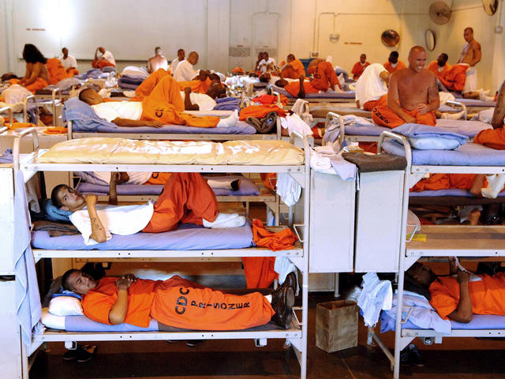
Observation #1
Correctional facilities are high incidence TB settings with a high risk for TB transmission.

Slide 5
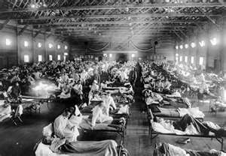
Soldiers from Fort Riley, Kansas ill with Spanish influenza at a hospital ward in 1918

Slide 6
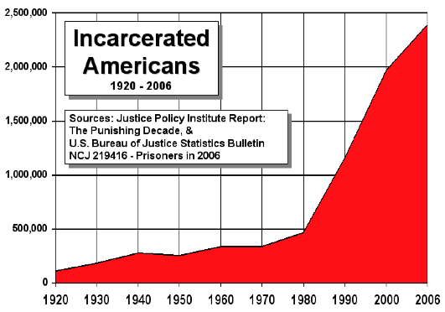
Epidemic of Incarceration
In 2010, 2.3 million persons were incarcerated in the U.S.

Slide 7
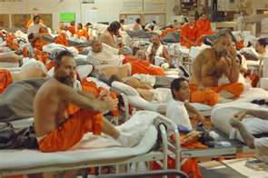
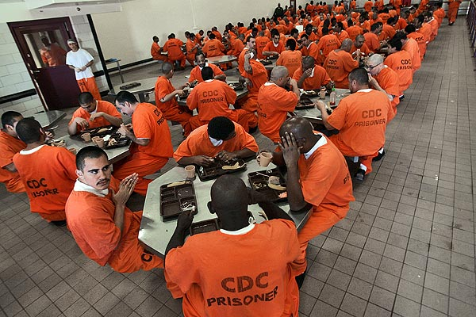
Incarceration in the United States
Incarceration Rate (2010): 962 inmates/100,000 adults
From 1980 to 2008 incarcerated population increased >600%
2009 & 2010 showed first declines in incarcerated population since 1980

Slide 8
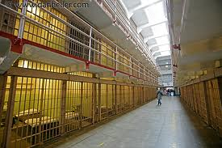
Epidemic of Incarceration
Untreated mental illness
Deinstitutionalization / dissolution of mental health care facilities
Untreated substance abuse (40-50%)
Criminalization of drug use
Mandatory minimum sentencing, etc.
Incarceration of undocumented immigrants

Slide 9
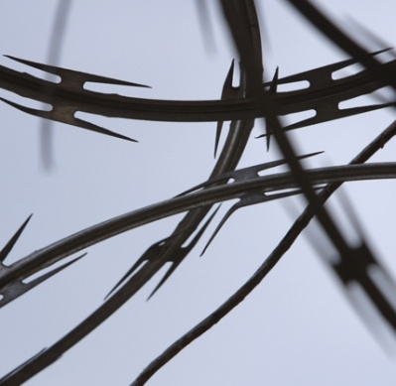
Correctional Facilities
Jails/Detention Centers
Usually administered by local law enforcement
Incarcerates
pretrial inmates
inmates with < 1 year sentence
State prisons
Sentenced inmates
Federal prisons
Pretrial & sentenced inmates related to federal crimes

Slide 10
Private Correctional Facilities
Private companies contract with governments that commit prisoners and pay per diem or monthly rate per prisoner
Privatization refers to:
management of existing public facilities by private operators
building and operation of new and additional prisons by for-profit prison companies.
In 2010, 12.7% of federal inmates and 7.5% state inmates were housed in privately run facilities

Slide 11
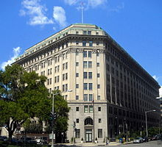
Federal Correctional System
Federal Bureau of Prisons (FBOP)
132 facilities (includes 16 contract facilities)
Average census 2010: 196,166 (25% foreign born)
U.S. Marshals Service (USMS)
Responsible for inmate transport
Contracts with ~1800 correctional facilities (often local jails)
Detained prisoners in 2010: 225,329

Slide 12
Federal Correctional System
U.S. Immigration and Customs Enforcement (ICE)
11 detention facilities (includes 5 contract facilities)
Contracts with ~240 additional correctional facilities (often local jails)
Removals in FY2010: 392,862 (100% foreign born)

Slide 13
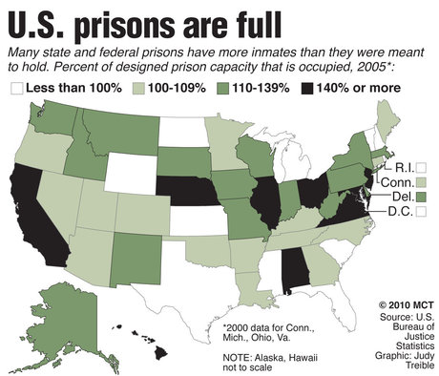
State & Federal Prisons: Percent of Designed Prison Capacity That Is Occupied, 2005

Slide 14
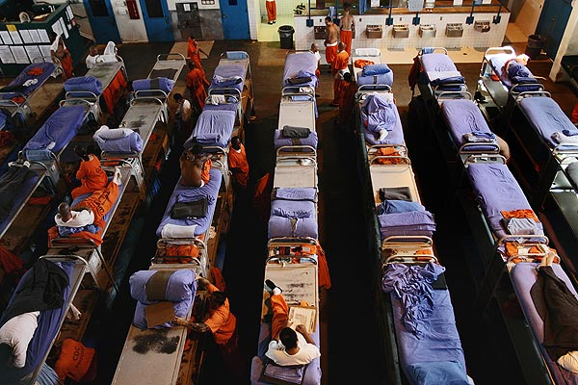

Slide 16
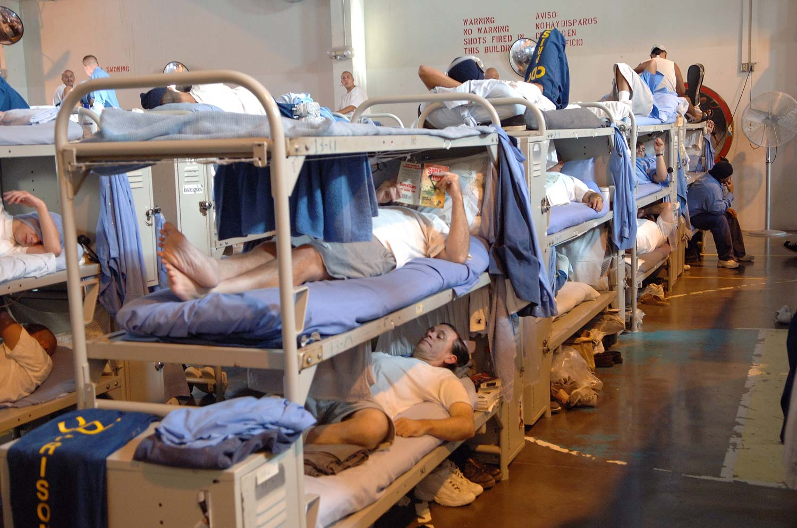

Slide 17
TB Incidence — United States,
2006–2010
TB incidence among inmates diagnosed in correctional facilities is 5 times greater than for the general population of the U.S.

Slide 18
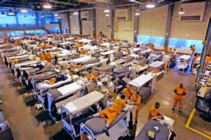
Tuberculosis & Incarceration
Inmates at high risk for TB:
HIV, foreign birth, substance abuse, lower socio-economic status
Congregate setting
overcrowding / poor ventilation
Frequent inmate movement

Slide 19
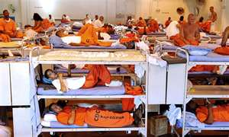
TB & Incarceration
Numerous outbreaks in correctional facilities reported in literature with evidence of transmission to nearby communities^{1,2}
Outbreaks frequently associated with delay in diagnosis of active TB
Crowding associated with higher incidence of TST conversion³
¹ Bur S, Golub JE, et al. Int J Tuberc Lung Dis. 2003 7(12 Suppl 3):S417-23.
² CDC. Tuberculosis Transmission in Multiple Correctional Facilities --- Kansas, 2002—2003. MMWR 53(32) 734-738
³ MacIntyre CR, Kendig, et al. CID 1997;24:1060-1067.

Slide 20
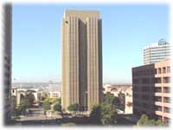
MDR-TB in a Federal Pretrial Facility

Slide 21
MDR-TB in Federal Pretrial Facility (2010)
57 year old Tijuana taxi driver crossed Mexico border into U.S.
Picked up by Customs and Border Protection
Immediately hospitalized with alcoholic hepatitis
History of Type II Diabetes on metformin. Started prednisone→ insulin dependence
One week later moved to FPF
Portable chest x-ray (CXR) read as “negative”. No TB symptoms

Slide 22
MDR-TB in Federal Pretrial Facility (2010)
Three months later diagnosed with pulmonary tuberculosis
Cavitary CXR, AFB smear positive
Cough x previous 6 weeks with hemoptysis
Two months later: Susceptibility Results →
Resistance to rifampin, isoniazid, pyrazinamide, streptomycin
Re-read of initial CXR: “subtle evidence of upper lobe disease”

Slide 23
MDR-TB in Federal Pretrial Facility (2010)
Index case housed on 120 bed unit during infectious period:
total of 131 days
including 41 days after returning from initial hospitalization on standard 4-drug therapy.
Very high turnover
Never left unit – meals/recreation occur on unit

Slide 24
MDR-TB in Federal Pretrial Facility (2010)
388 inmate contacts identified
Prior Positive TST: 155/384 = 40%
25/117 (21%) U.S. Born
130/267 (49%) Foreign Born
Inmate TST conversions: 29 /158 (18%)
9/66 (14%) U.S. Born
20/92 (22%) Foreign Born
17/69 (25%) Housed in same Quarter
Staff TST conversions: 4/87 (4.6%)
One clinical case of lymphatic TB – HIV infected inmate.

Slide 25
MDR-TB Contact Treatment Protocol
Documented TST Convertors, HIV-infected, Prior Positive TST & Shared the Same Quarter
Daily Moxyfloxacin & Ethambutol
9 months HIV-negative
12 months HIV-positive

Slide 26
Federal Bureau of Prisons Federal Pretrial Facility
MDR-TB Contact Investigation:
Dispersal of 388 Inmate Contacts
12 Weeks into the Investigation, 2010

Slide 28
Observation #1
Correctional facilities are high incidence TB settings with a high risk for TB transmission.

Slide 29
Observation #2
Correctional facilities are high TB incidence settings often located in low incidence communities that lack TB expertise.

Slide 30
TB in Correctional Facilities
Correctional facilities are TB high incidence settings often located in low incidence communities
Health care providers in low incidence communities often lack experience with TB diagnosis and treatment
Jail/Prison health services staff
Local community physicians

Slide 31
Observation #3
Public health / corrections collaboration is key to TB prevention & control in correctional facilities.

Slide 32
Examples of Deliverables
Public Health
Correctional Facilities
Consultation
TB diagnosis & treatment of cases
Release Planning
Contact Investigation
Policies/Procedures
TB education
Case Detection
Case Reporting
Active TB Treatment
Release Planning
Contact Investigation
Treatment of Latent TB Infection

Slide 33
Culture of Corrections
Security ALWAYS comes first

Slide 34
Observation #4
Ongoing TB education of correctional healthcare workers and custody staff, as well as inmates, poses major challenges.

Slide 35
Observation #5
Release planning for inmates with active TB is a critical aspect of TB control in correctional facilities.

Slide 36
Observation #6
Correctional facilities provide opportunities for TB prevention & control.

Slide 37
Opportunities for TB Control
TB Case Detection
in hard-to-reach high risk populations
Treatment of Latent TB Infection
INH/Rifapentine – Extraordinary Opportunity
INH: 72 twice weekly doses
INH/Rifapentine: 12 once weekly doses

Slide 38
Conclusion
Allocation of limited public health resources should reflect the fact that correctional facilities are high priority settings for TB prevention and control.

Slide 39
Recommendations

Slide 40
Recommendations for ACET
Add to ACET membership a liaison representing jail systems.
Develop a National Strategy. Create a work group focusing on corrections representing ACET, DTBE and NTCA and correctional partners to develop a national strategy for improving TB prevention & control in correctional & detention facilities.

Slide 41
Proposed ACET Recommendations for CDC
Leadership.
DTBE develops a strong national leadership role related to TB prevention & control in correctional facilities.
Assess need to reallocate resources to accomplish this.

Slide 42
Proposed ACET Recommendations for CDC
Collaboration.
Develop collaborative relationships with key national correctional partners (ACA, NCCHC, AJA, NSA, national correctional health care corporations, etc.)
Create public/private partnerships to enhance implementation of TB guidelines and provision of TB education.
Promote collaboration between health departments and correctional facilities (via the Cooperative Agreement and other venues).

Slide 43
Proposed ACET Recommendations for CDC
Surveillance & Research:
Conduct analysis of RVCT corrections TB data.
Assess if additional incarceration data should be collected when changes are made to RVCT.
Identify needed research related to TB in CFs

Slide 44
Proposed ACET Recommendations for CDC
TB Education of Correctional Workforce:
Work with RTMCCs to:
Identify & characterize target populations (health care workers, custody staff, inmates)
conduct needs assessment
develop & implement plan for ongoing TB education.

Slide 45
Proposed ACET Recommendations for CDC
Support TB Prevention & Control Efforts of Federal Correctional Partners
ICE, USMS, BOP
> 750,000 federal detainees
Explore use of PCSI funds to provide staff support

Slide 46
Prevention & Control of
Tuberculosis in Prisons & Jails

Slide 47
Prevention & Control of
Tuberculosis in Prisons & Jails

Slide 48
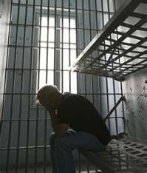
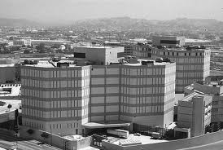
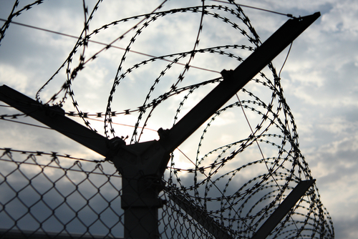
Questions/Discussion

