Slide 1
Community of Practice December 12, 2019 Session #1 Writing the Co-Ag APR/Close out Report

Slide 2
Hub Team Members
Nancy Baruch nancy.baruch@maryland.gov
Heidi Behm Heidi.BEHM@dhsoha.state.or.us
Jason Cummins Jason.cummins@tn.gov
Peter Davidson DavidsonP@michigan.gov
Pete Dupree peter.dupree@state.co.us
Julie Higashi JHigashi@ph.lacounty.gov
Dee Pritschet djpritschet@nd.gov

Slide 3
Utilizing Poll Everywhere
Go to your web browser
computer or smart phone
Type in Pollev.com/ntcacop

Slide 4
December 12, 2019 Agenda

Slide 5
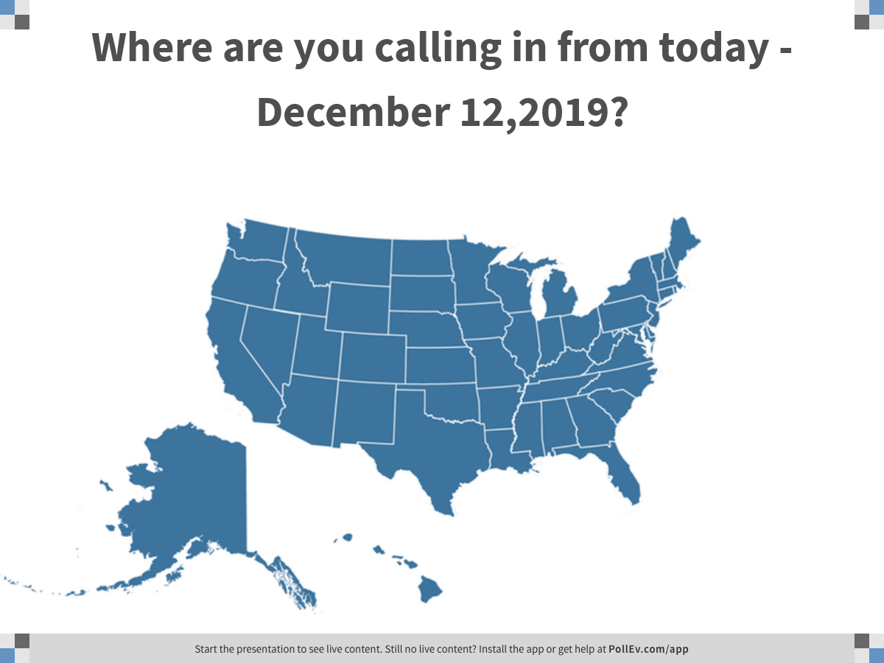
Notes:
Where are you calling in from today - December 12,2019?
https://www.polleverywhere.com/clickable_images/gCNxYgX8iAe8tFcsl9nJZ

Slide 6
Notes:
Have you been contacted by your CDC Program Consultant about the releases of 2020 Co-ag funds
https://www.polleverywhere.com/multiple_choice_polls/RrccQBKniprvFHbw8mrmv

Slide 7
Notes:
If yes, what were you told.
https://www.polleverywhere.com/free_text_polls/vllIXc3R85iVA2CRj6Koo

Slide 8
Notes:
Did you receive an email from Adam Langer regarding the accelerated timeline for reporting 2019 surveillance data?
https://www.polleverywhere.com/multiple_choice_polls/zgFFPLLPpVXoOffrMY8r7

Slide 9
Notes:
Will this earlier timeline be challenging to meet?
https://www.polleverywhere.com/multiple_choice_polls/QaNsG53tdhL0cljuT5mGp

Slide 10
Notes:
Would it be possible for you (or another staff member) to attend a 2 and1/2 day training for the 2020 RVCT changes if it were scheduled immediately following the 2020 National TB Conference? It would run from Friday afternoon until Sunday afternoon.
https://www.polleverywhere.com/multiple_choice_polls/TE3bb721wF0fZ7u65nSXl

Slide 11
Resources Pages
NTCA CoP Resource page
http://http://www.tbcontrollers.org/resources/community-of-practice/#.XfJVMC2ZOYUwww.tbcontrollers.org/

Slide 12
Our NEXT Session
January 16, 2020
Agenda: Writing your state TB Elimination Plan
This same zoom link will be used each time

Slide 13
Notes:
What topic(s) would you like to see covered next?
https://www.polleverywhere.com/free_text_polls/Yv74rUeeZzXqSDNZeOQWo

Slide 14
THANK YOU! For your participation in the Community of Practice

